Slide 1
Computer Simulation and Risk Assessment
By Riya Ohri

Slide 2
ETF INDEX
XLF SECTOR
Emphasis on Financial Sector
The financial services sector comprises 20-25% of the world economy
Predominately operates in the United States and Canada (95.67% of Equity), followed by Europe (3.43%), and Latin America and the Caribbean (0.91%)
Concentrated in large banks
72 underlying holdings

Slide 3
TOP 10 HOLDINGS
Sr.No | Name of the Company | Symbol | Weight | Price
1 | Berkshire Hathaway Inc. | BRK-B | 13.26 | 4,901.2
2 | JPMorgan Chase & Co. | JPM | 10.1 | 3,733.9
3 | Visa Inc. | V | 7.8 | 2,881.5
4 | Mastercard Incorporated | MA | 6.91 | 2,553.4
5 | Bank of America Corporation | BAC | 4.48 | 1,654.0
6 | Wells Fargo & Company | WFC | 3.65 | 1,349.0
7 | S&P Global Inc. | SPGI | 2.43 | 898.5
8 | The Goldman Sachs Group, Inc. | GS | 2.32 | 857.1
9 | American Express Company | AXP | 2.23 | 825.1
10 | The Progressive Corporation | PGR | 2.12 | 782.8

Slide 4
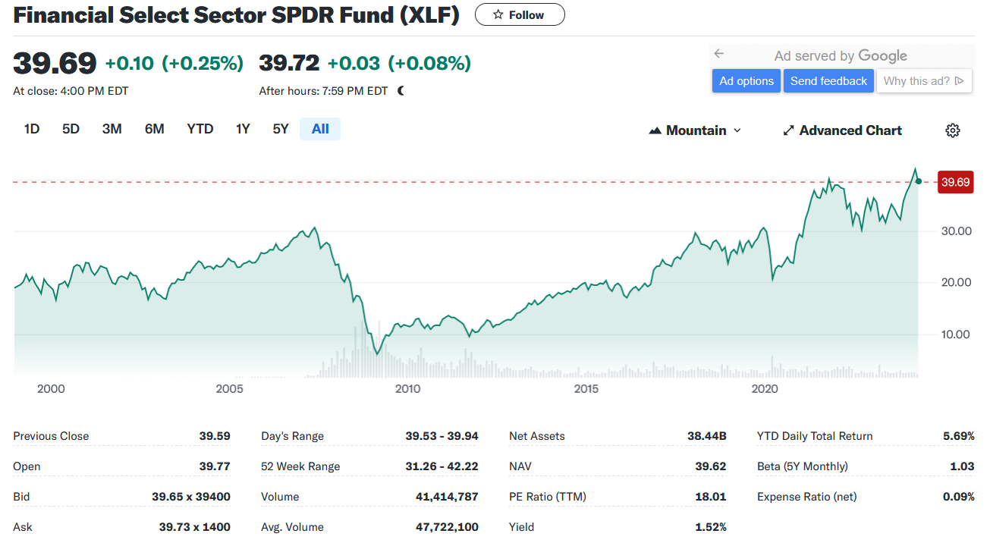
BENCHMARK PERFORMANCE
Source: Yahoo Finance

Slide 5
INVESTMENT INSIGHTS
Highly Volatile Index
High Risk, high return and vice-versa
Risk Diversified
Soaring Price
Low Beta

Slide 6
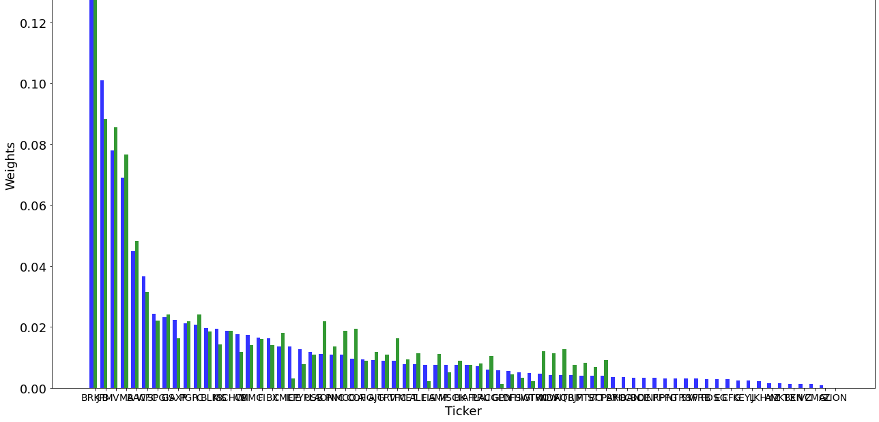
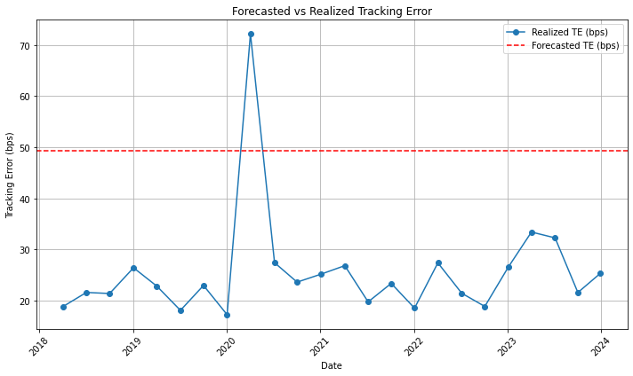
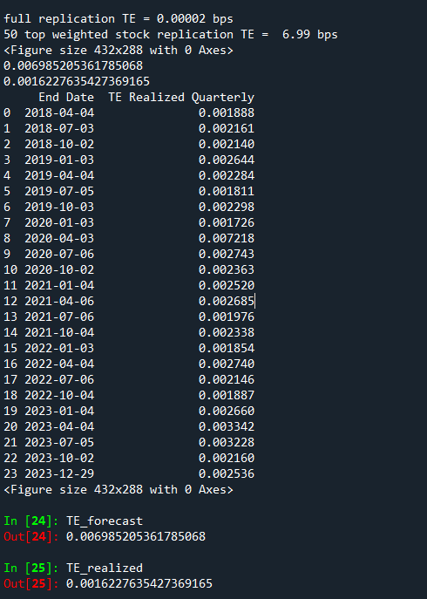
RESULTS OBTAINED
Notes:
-dataset – why 50 stocks – historical weights and how we tweaked it to get min te – EWMA model we trained further data – using optimal weights we got forecasted TE as shown in console picture – forecast > realized – to make our model more accurate we used quarterly rolling window where the dataset was split in 3 months period

Slide 7
OPTIMIZATION OF RISK-PARITY PORTFOLIO
Data Gathering
Volatility Calculation
Covariance Matrix Calculation
Portfolio weight optimization
Portfolio Re-balancing
Results obtained
Notes:
Wgt opt – risk parity approach to min risk parity score and wgts are assigned such that the risk of port remains minimal in relation to returns– rebal – then we rebalanced port every month based on the new data st if the asset became riskier the wgt reduced and redist. Among other assets ex. As an outcome – we get a well balanced port.

Slide 8

PORTFOLIO PERFORMANCE & ANALYSIS
Portfolio Returns
Insights
Evaluation Metrics
Implications
Notes:
- Monthly portf ret & monthly wgts – peaks in the graphs shown represents different market and economic turns or change in asset prices – used sharpe ratio, mean and sd for portf evaluation which in turn will help us understand portfolio’s performance in respect to risk and compare to the benchmark

Slide 9
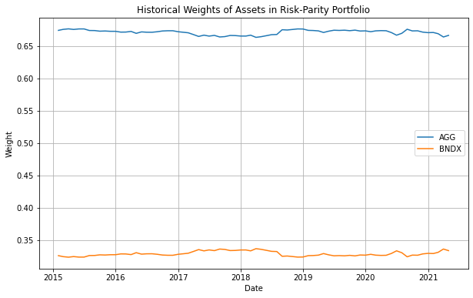
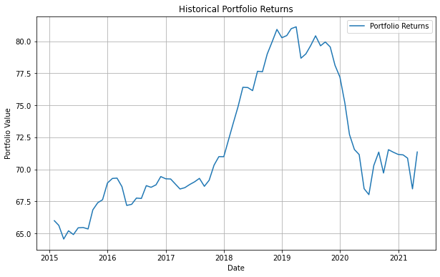
ANNEXURE 1
SHARPE RATIO: 14.619

Slide 10
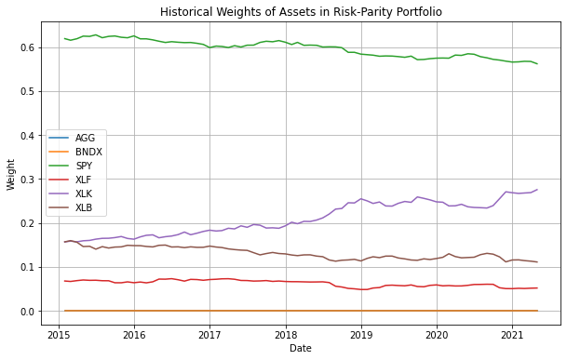
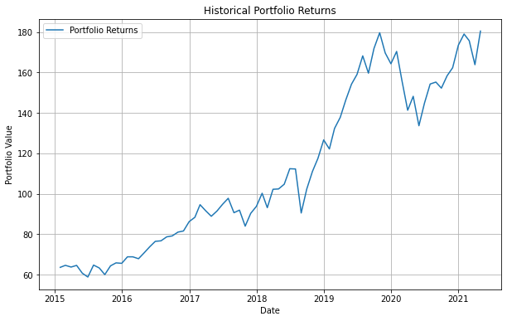
ANNEXURE 2
SHARPE RATIO: 2.846

Slide 11
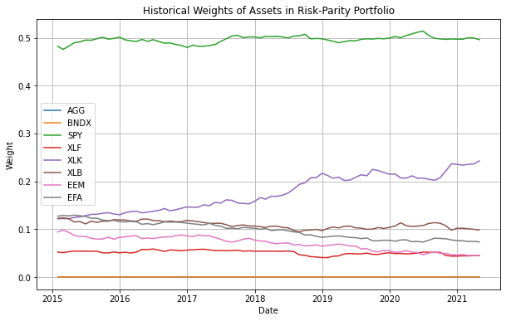
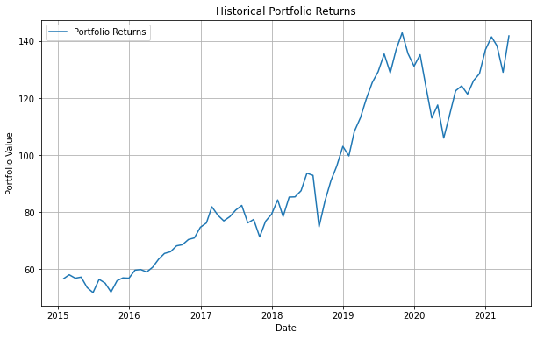
ANNEXURE 3
SHARPE RATIO: 3.163

Slide 12
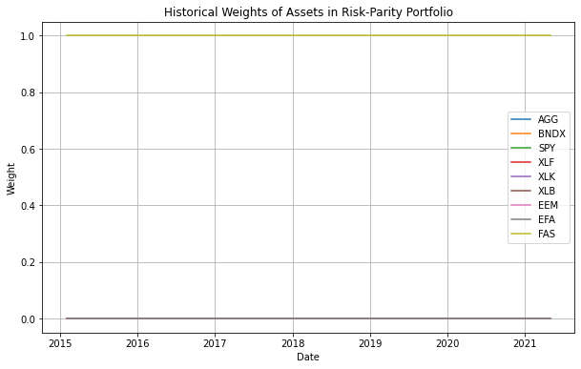
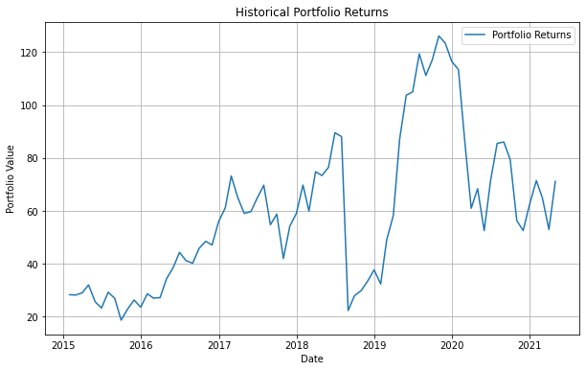
ANNEXURE 4
SHARPE RATIO: 2.104

Slide 13
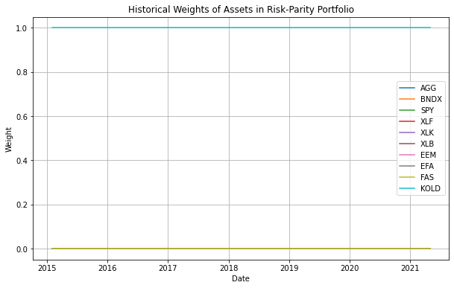
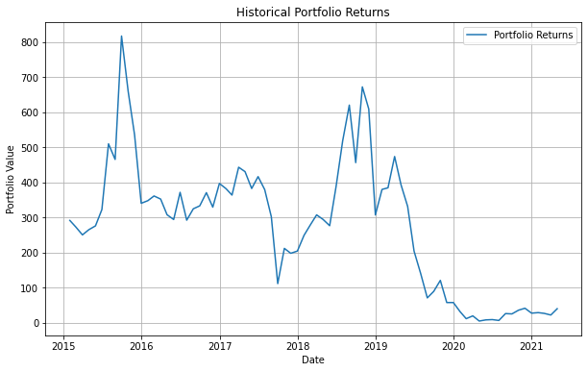
ANNEXURE 5
SHARPE RATIO: 1.481

Slide 14

THANK YOU

